Slide 1

Creating your own quiz
This quiz will go with your PowerPoint. It will be created to test students on the information they have read in your PowerPoint and to see if they were concentrating. There will be 10 questions in the quiz that you will have to make with four different answers for each.
Click here to open the quiz webpage

Slide 2
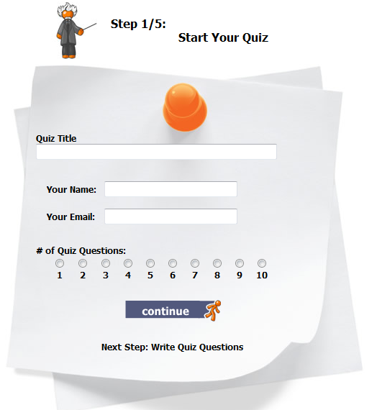
Type you and your partners name and the name of your quiz. For example Sarah and Jane- Living things
Type your name and your partners name
Type your school email
Choose 10 questions
Click continue

Slide 3
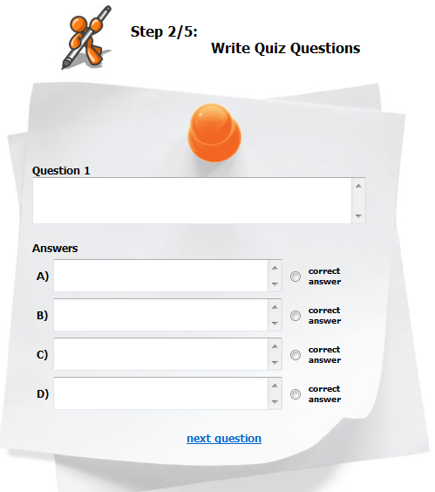
Type your quiz question here
Type your 1st answer here
Type your ^{2nd} answer here
Type your ^{3rd} answer here
Type your ^{4th} answer here
Click on the circle which is the right answer to the question

Slide 4
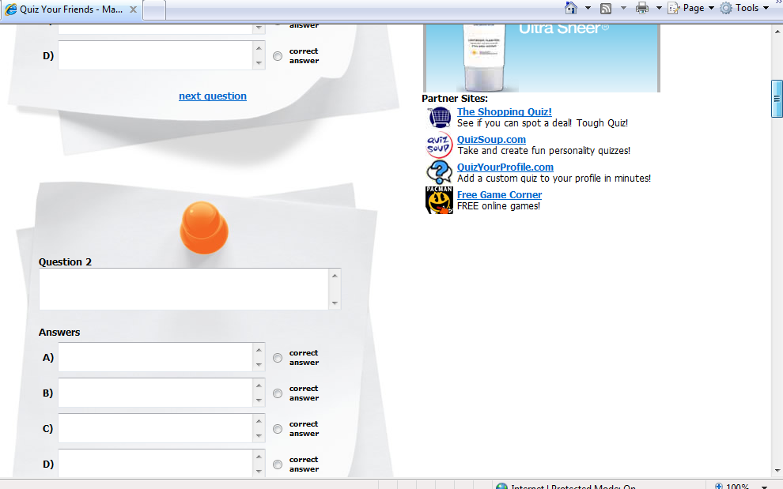
Type question 2 here and the answers in the answer boxes and don’t forget to click which is the right answer.
Once you have finished with question 1 scroll down to the next question

Slide 5
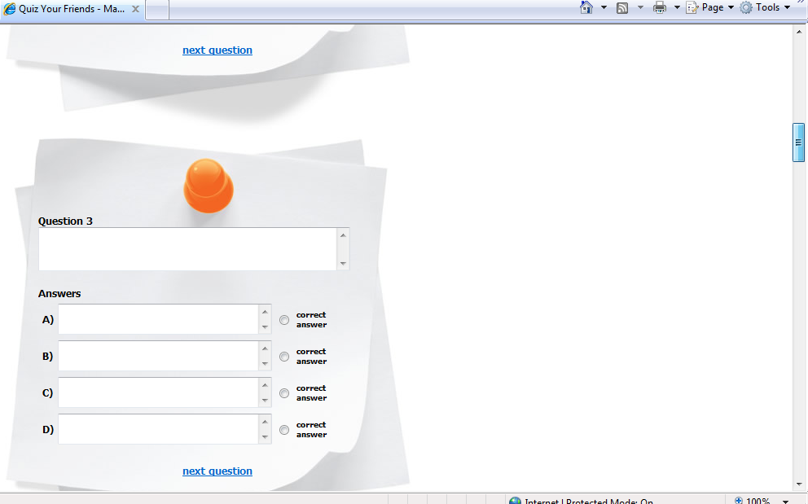
Fill out each question as you did for question 1 and then keep scrolling down
Once you have finished with question 2 scroll down to the next question

Slide 6
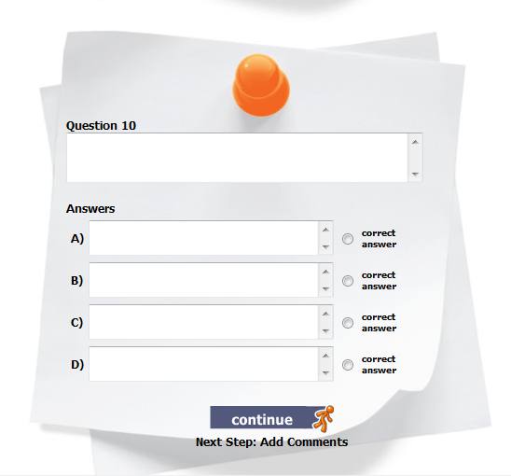
Write your question here just as you have for the previous 9 questions
Don’t forget to choose which answer is correct
Click continue when you have finished all 10 questions

Slide 7
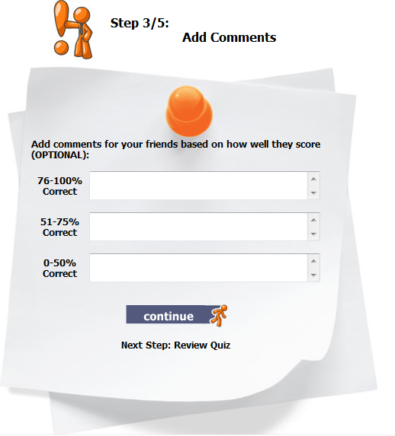
You could right something positive here for example “Well done you have studied hard”
For this one you could right something like “Good work but I think you can do better”
Good try. Do some more revision and try this quiz again!
Click continue when you’re finished

Slide 8
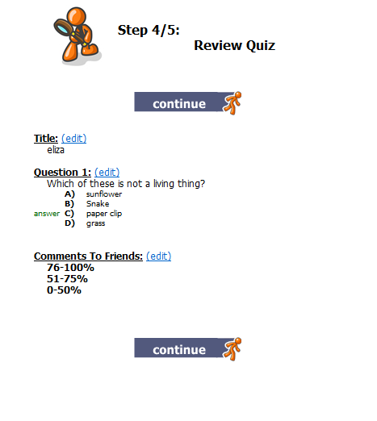
Click this continue if you DO NOT wish to edit or change anything in your quiz
Click edit here if you wish to change the title of you quiz
Click edit here if you wish to change any of the questions or answers
Click here is you wish to edit the comments you made about the marks
Click this continue after editing any of the areas above

Slide 9
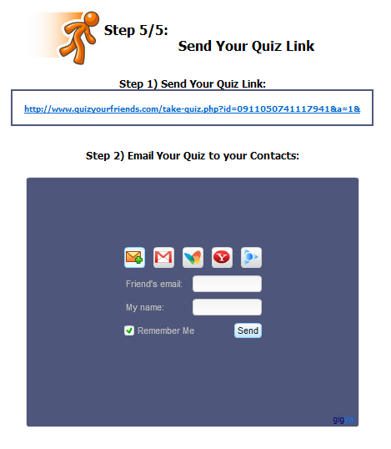
This is the web address to you quiz!
You do not need to use this step because you are going to post your link in your PowerPoint.

Slide 10
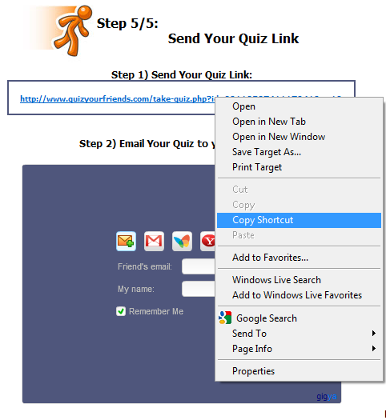
Hover your mouse over the website address and right click.
When you right click the following menu will appear. Click on copy short cut.

