Slide 1
Creating a hyperlink in PowerPoint

Slide 2

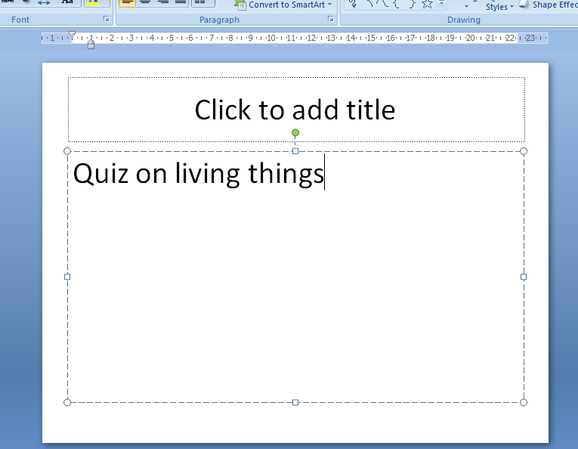
Go back to your PowerPoint where you have written ‘Quiz on Living things’

Slide 3
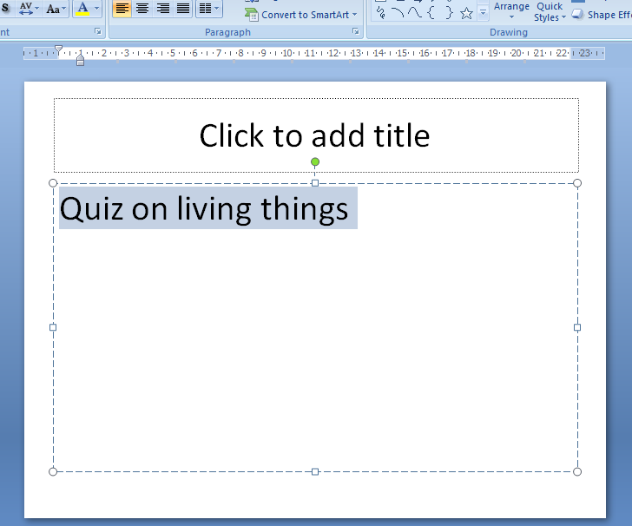
High light the heading with your mouse and kept the mouse over the highlighted area

Slide 4
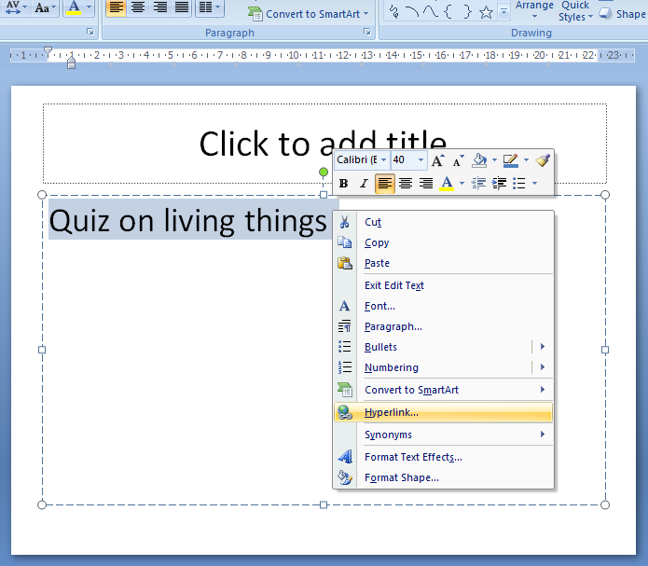
Click Hyperlink

Slide 5
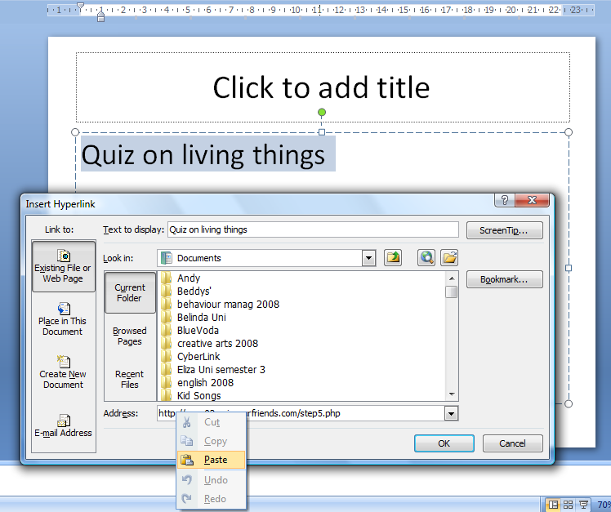
Once this box is empty, right click in the address bar and click paste
Delete this first

Slide 6
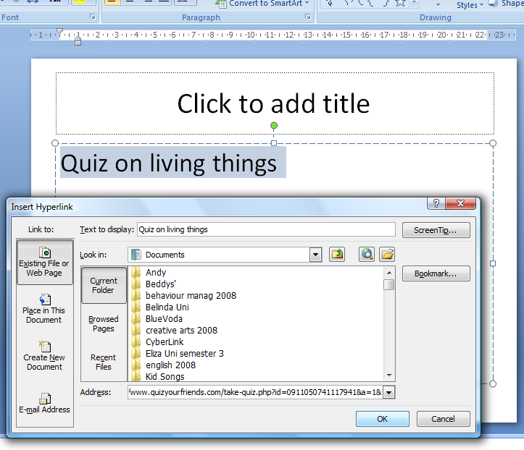

Slide 7
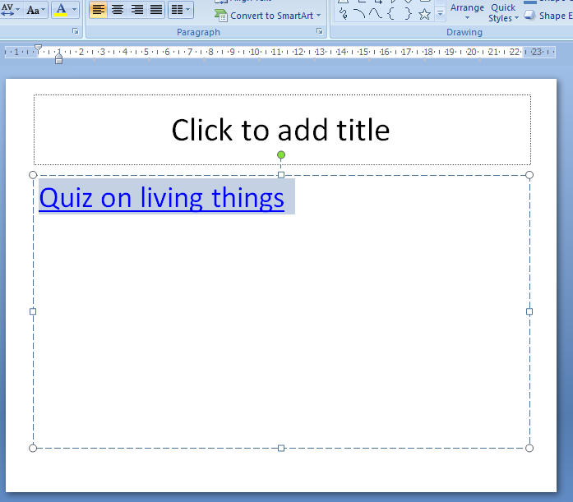

Slide 8
YOUR FINISHED WELL DONE!
Show the teacher and if your PowerPoint is completed it will be uploaded to the internet!

